Slide 1



In the Black: An Exploration Into Gambling Revenue, Taxes, and Economic Impact
Liam Riener and Kieran Santos

Slide 2
Agenda
1.
Research Question
2.
Dataset
3.
Exploratory Analysis
4.
Modeling
5.
Implications/Conclusion

Slide 3
Agenda
1.
Research Question
2.
Dataset
3.
Exploratory Analysis
4.
Modeling
5.
Implications/Conclusion

Slide 4
Research Question
How Does Taxation Affect Gambling Activity by State and Economic Scale?

Slide 5
Agenda
1.
Research Question
2.
Dataset
3.
Exploratory Analysis
4.
Modeling
5.
Implications/Conclusion

Slide 6
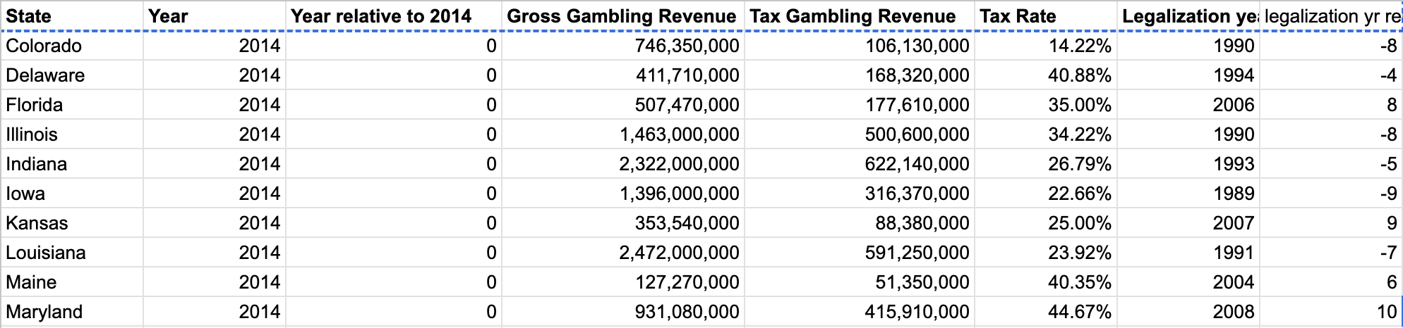
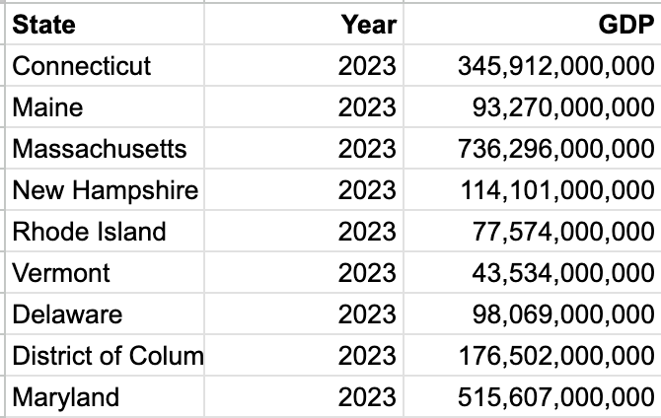


Dataset
Gambling and Tax Revenue Dataset
280 Rows - States by Year
9 Columns - State, Year, Year relative to 2014, Gross Gambling Revenue (in Millions), Tax Gambling Revenue (in Millions), Tax Rate, Legalization year, Legalization yr relative to avg (1998)
GDP Dataset
511 Rows - States by Year
3 Columns - State, Year, GDP (in Billions)
Via State of States (2014-2023), https://www.americangaming.org/research/state-of-play-map/
Via GDP by State 2014-2023, U.S. Bureau of Economic Analysis (BEA) reports from 2016-25

Slide 7
Agenda
1.
Research Question
2.
Dataset
3.
Exploratory Analysis
4.
Modeling
5.
Implications/Conclusion

Slide 8
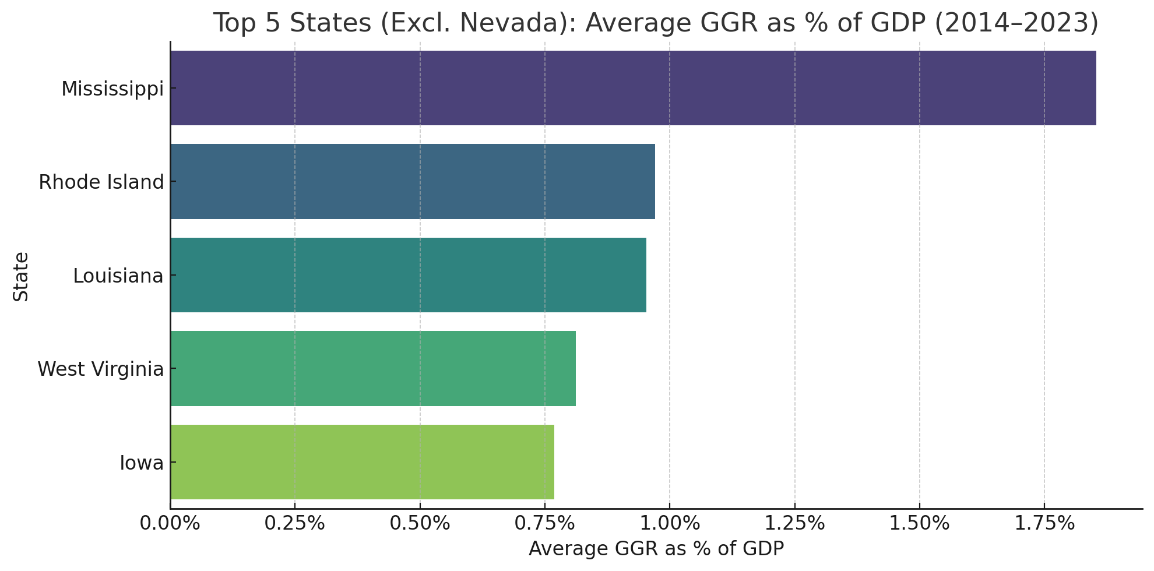
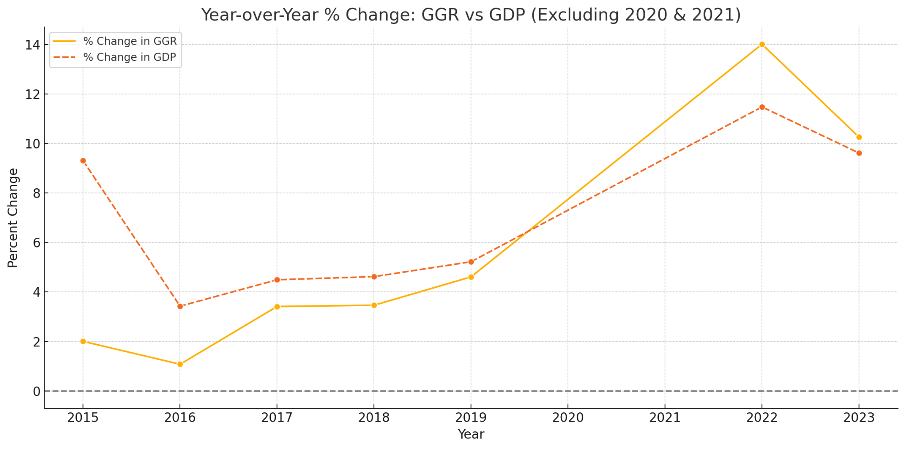
Commercial Gambling Industry 2014-2023
Exploratory Analysis
Revenue: Average of 0.66% of GDP in legal states. 1/150th of economy in legalized states, estimated 1/300th of US economy
7% (!!!) of NV economy, 2% of MS, <1% elsewhere
Gambling revenue growth outpacing growth of total economy, flipped post-COVID
Pivotal 2018 SCOTUS decision
2020 COVID dip, 2021 rebound

Slide 9
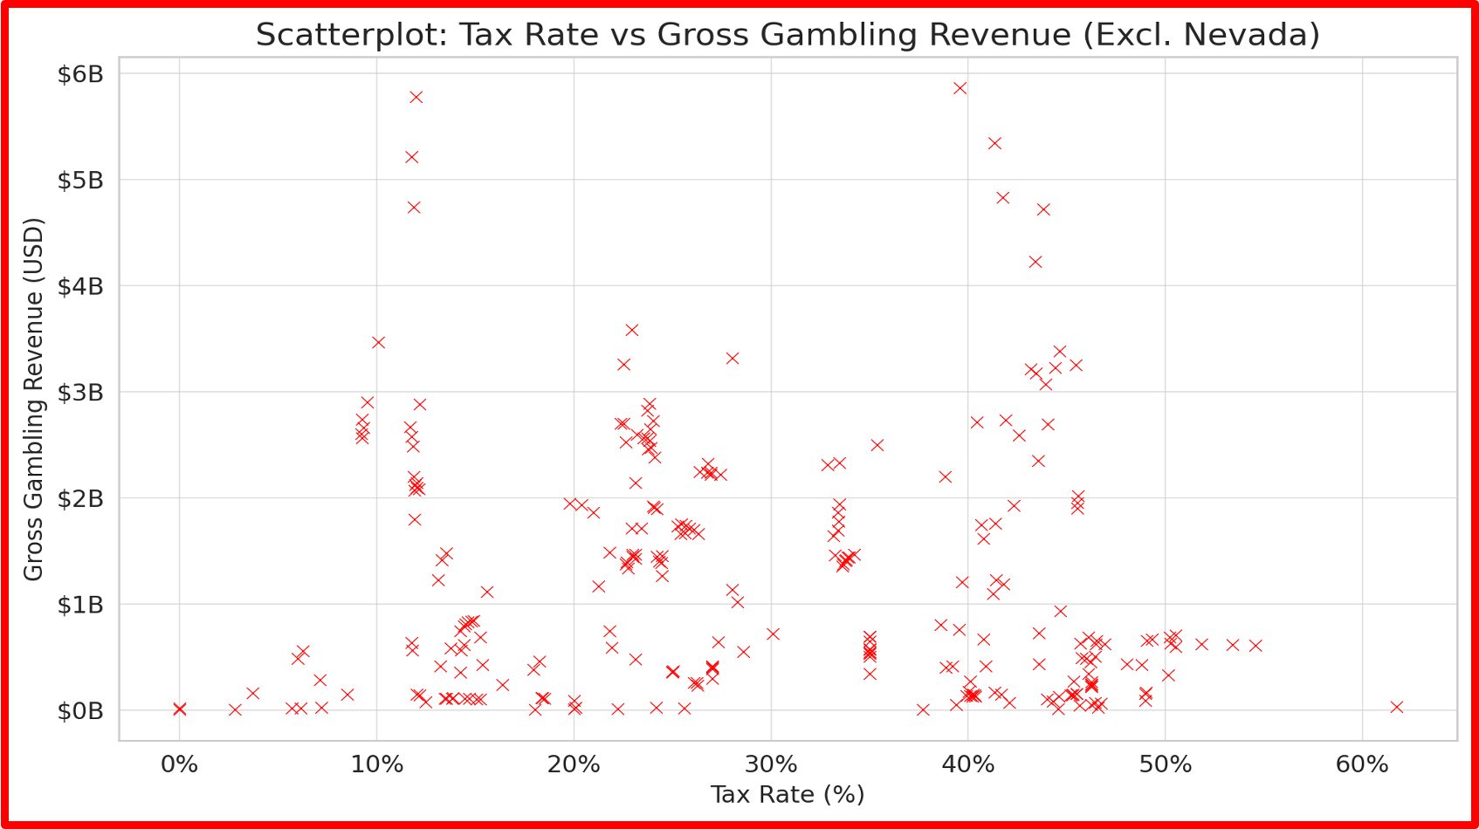
Taxation of Gambling Revenue 2014-2023
Exploratory Analysis
Wide variety of tax rates, structures (by casino, flat, progressive)
Weak correlation with gross revenue (-0.3), even weaker w/o Nevada (-0.1)
Positive but weak correlation with legalization year relative to 1998 (avg yr of legalization) (0.29), even weaker without Nevada (0.1)
Tax rate weak negative correlation with year relative to 2014 (-0.097)
Tax rate for gambling weak positive correlation (0.13) with GDP

Slide 10
Agenda
1.
Research Question
2.
Dataset
3.
Exploratory Analysis
4.
Modeling
5.
Implications/Conclusion

Slide 11
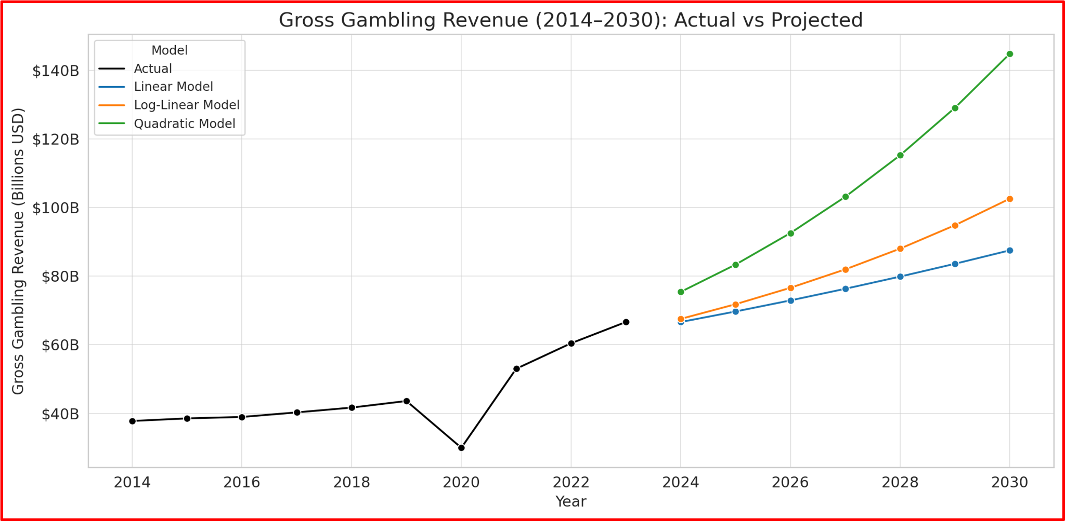
Nationwide Model
Modeling
Science Presentation
Models based on 5% GDP growth each year, strong correlation (0.84) between GDP and GGR growth
Linear: GGR=5.17B+0.0036⋅GDP
Log-Linear: log⁡(GGR)=a+b⋅GDP
Quadratic: GGR=79B−0.00929⋅GDP+5.32×10−16⋅GDP2
Models dependent on stable economy, lack of public resistance to gambling industry
2018 SCOTUS decision pivotal-> online gambling
Will CA and TX (Tribal only) legalize?

Slide 12
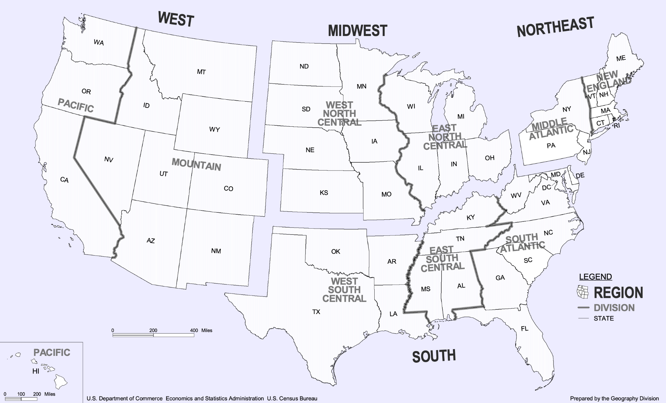
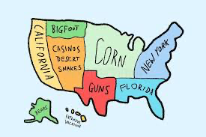
Regional Models
Modeling
Science Presentation
Models based on 5% GDP growth each year, strong correlation (0.84) between GDP and GGR growth
4 regions based on US census divisions
Used to see where industry growth is coming from, projecting futures more specifically
Profits in Northeast and Midwest regions growing more rapidly-> more legalization
South and West more stagnant: stability of Nevada (about half of region’s GGR), Louisiana and Mississippi in the South

Slide 13
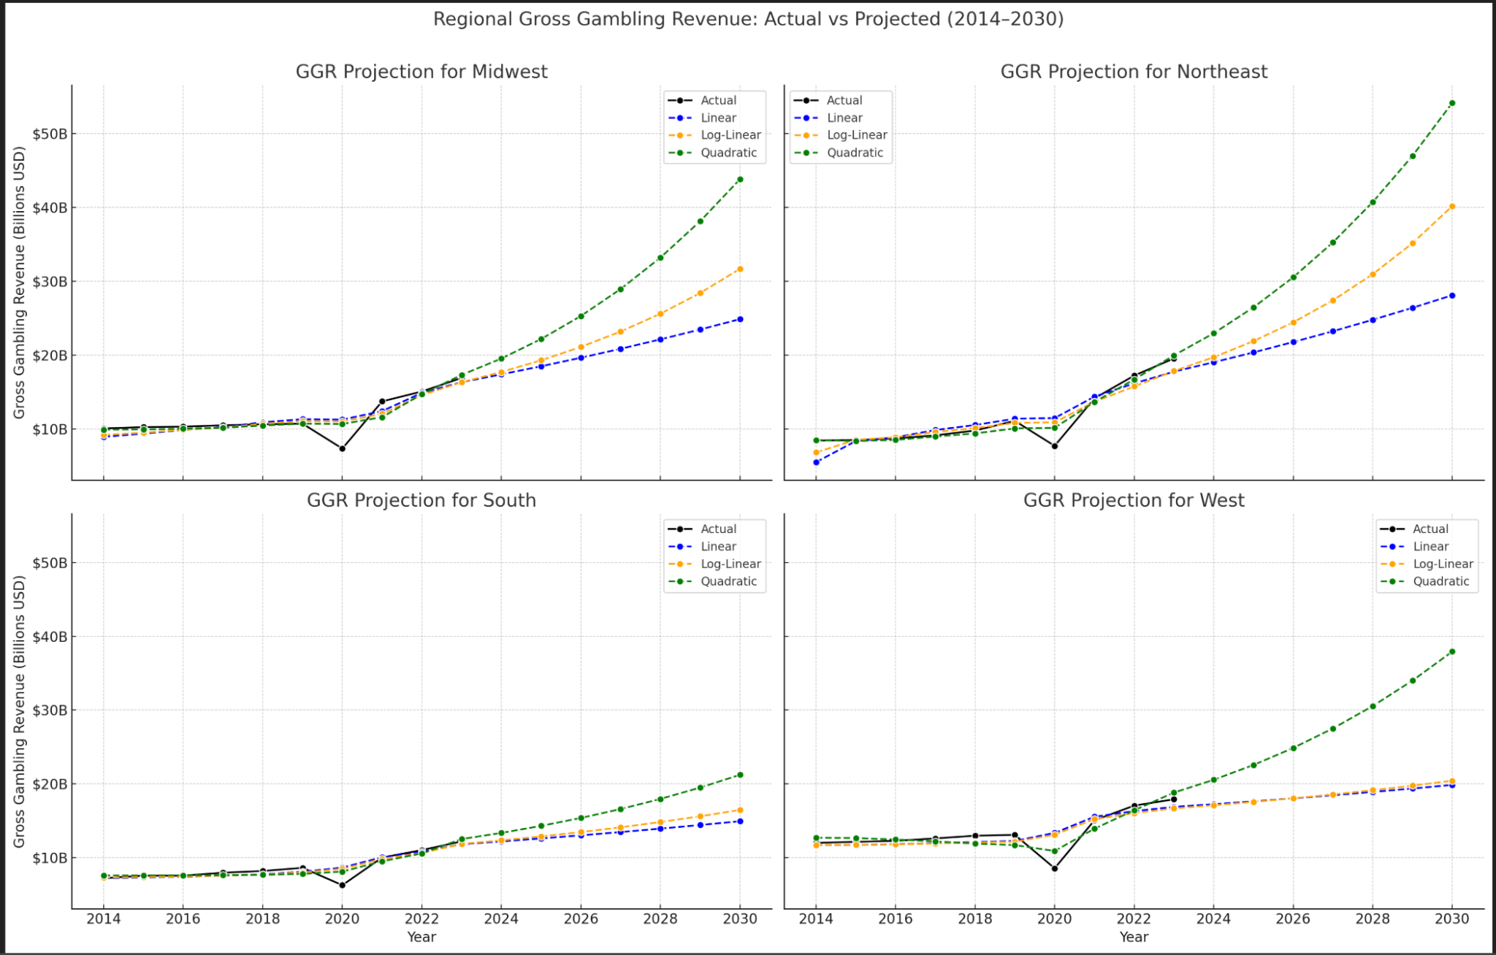
Modeling
Science Presentation

Slide 14
Agenda
1.
Research Question
2.
Dataset
3.
Exploratory Analysis
4.
Modeling
5.
Implications/Conclusion

Slide 15

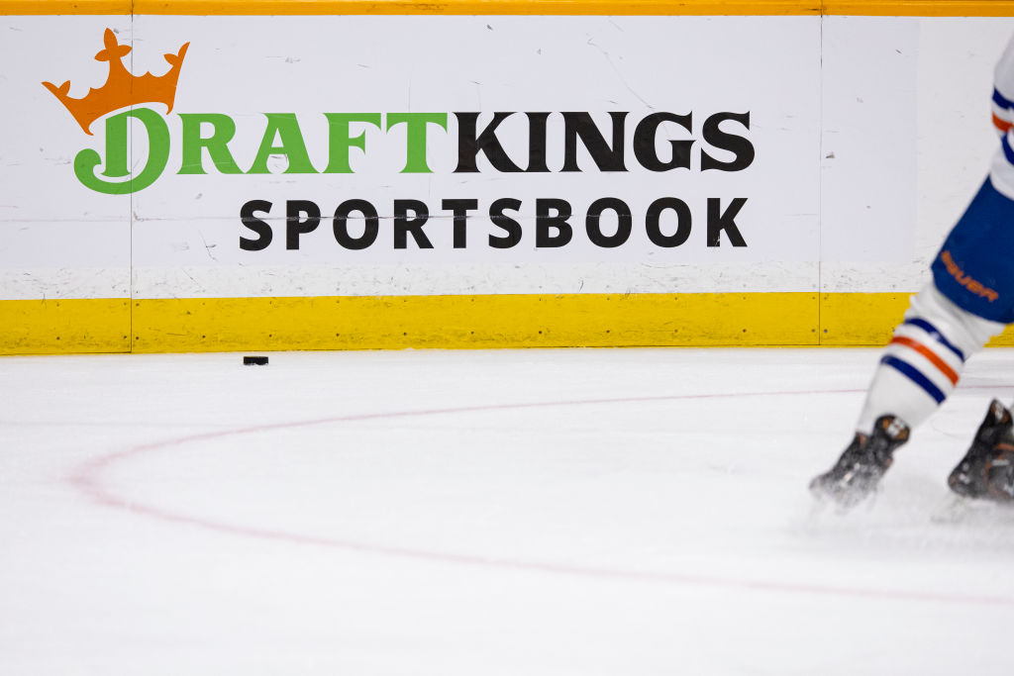
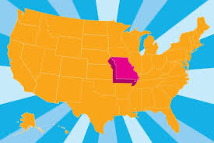
Implications/Conclusions
Science Presentation
Growth of Online Gambling,
Especially Sports Gambling
30% of all commercial gaming revenue came from digital sources in 2024, compared to 25% in 2023, 13% in 2021 (ESPN)
13.7 billion dollars in revenue from sports gambling in 2024 following 11.04 billion in 2023
Only one state (Missouri) set to legalize sports gambling in 2025: will growth stagnate?
Greenberg, Doug. ESPN, February 19, 2025. https://www.espn.com/espn/betting/story/_/id/43922129/us-sports-betting-industry-posts-record-137b-revenue-24

Slide 16

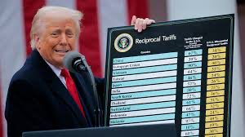


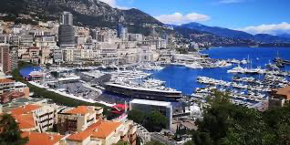
Implications/Conclusions
Science Presentation
Implications/Conclusions
Nev​ada is an outlier, although other states make nine figures
Weak correlation between taxes and total revenue
Commercial gambling in USA remains tied to the broader economy
States with lower GDPs have a higher rate of gambling
Study of international gambling (Macau, Monte Carlo, etc) helpful in further evaluation

Slide 17


Implications/Conclusions
Science Presentation
Final Takeaways for Policymakers
Moderate gambling tax increases are unlikely to deter industry revenue.
Economic growth supports gambling, not the other way around.
Smaller economies may be too reliant on gambling and need diversification.
Nevada’s unique profile should not guide national policy.
Legalization strategy should balance industry growth with public benefit. Online gambling is especially profitable and predatory, must be regulated effectively. If you need help, call 1-800-GAMBLER

